Slide 1
Image Classification using Pixel Generated Features
By Abolaji Shiwoku

Slide 2
Background of Image Classification in Medical Images
Google AI (Using AI to classify diabetic retinopathy in India)
Millions of people who suffer from diabetes will develop diabetic retinopathy, which can lead to blindness if not diagnosed in the early stages.
Due to India’s large rural population, many don’t have access to regular optometrist visits, which can lead to more expensive corrective measures.
Google AI decided to build a medical aide called ARDA (Automated Retinal Disease Assessment) utilizing supervised machine learning to identify features of diabetic retinopathy, such as retinal scarring, and tumors.
Software utilizes over 1 million retinal scans that have been labeled by ophthalmologists to assign retinal scans score ranging from 0-5, which specify the severity of the eye damage.
Diagnose Covid-19 using X-rays
A research team published an academic paper showing how they constructed a model to diagnose whether supplied X-rays displayed signs of covid induced pneumonia.
The model was trained on 1113 images of chest x-rays showing covid pneumonia, regular pneumonia, and no pneumonia.
Model has been utilized in hospitals across the globe to help doctors quickly diagnose patients during rush patient intake.

Slide 3
So why is ML so valuable to healthcare and treatments?
Use of automated ML systems can reduce the number of hours spent diagnosing diseases, and more time spent treating patients.
Machine learning models can be trained to identify diseases at early on stage, sometimes better than most experts.
Allowing software to drive the diagnosis of many common diseases can greatly lower the barrier or the discomfort of having to go to the doctor
ML can help doctors in clinical research in studying novel diseases by having access to similar disease data.

Slide 4
Problem Context
Using 18,000 labeled single cell blood images and machine learning, construct a model that can correctly identify the leukemia label of a supplied image.

Slide 5
Project Process
Analyze dataset (Determine class quantity, severity of class imbalance)
Identify important, descriptive features of each class to feed into ML model
Construct descriptive features for the images and, if necessary, standardize results.
Fit models to features and derive model predictions.
Determine model effectiveness and make improvements, then rerun model.

Slide 6
Data Analysis
Data is sourced from the Cancer Imaging Archive, and collected via M8 digital microscope using 100-fold optical magnification and oil immersion
Consists of over 18,000 labeled single-cell images with many forms of leukemia, divided into 15 classes highly imbalanced classes

Slide 7
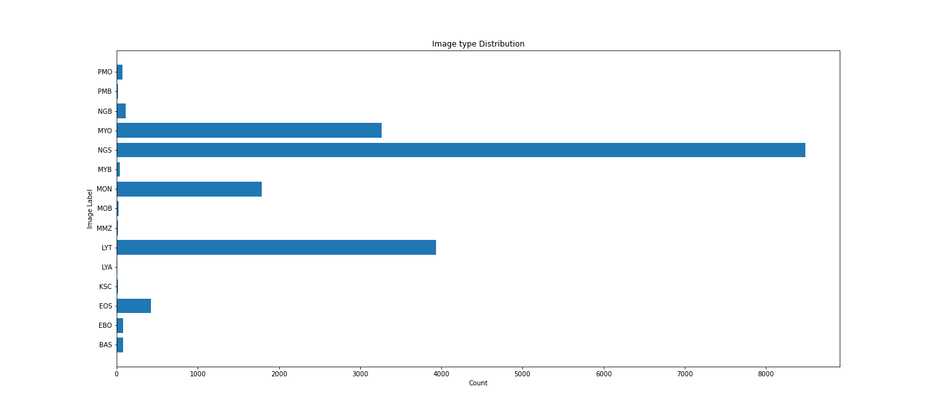
Histogram showing major class imbalance in dataset

Slide 8
Importance of features
Identifying important features of the image classes will be the determinant factor on the success of a classifier. A good classifier will learn the most distinguishing features, and use them to determine proper labels.
Eosinophil Promyelocyte Neutrophil (band) Basophil

Slide 9
Feature Engineering Process
Images in different classes seem to have
Varying number of local bodies within annotated cell.
Varying local blob sizes
Different shades of oil colorization
Note – These features are features than can be spotted with an untrained medical eye. In the real world, medical professionals will be informing the data scientists of other features, such as signs of cell deterioration, abnormal cell growth, and others.

Slide 10
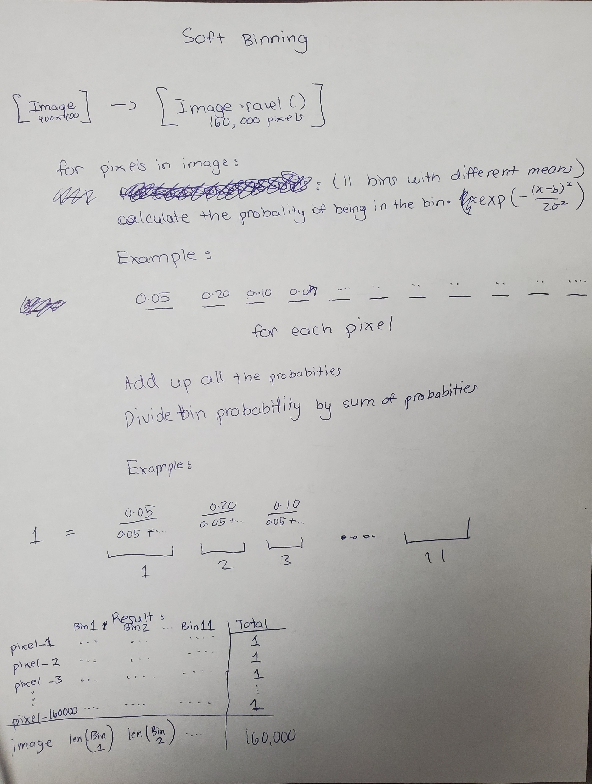
Illustration explaining the approach of the “soft binning” technique

Slide 11
Model Fitting
Once the features have been generated, the next step was to fit a ML model to learn the difference between the generated features.
The models that were chosen were Logistic Regression and SVM (Support Vector Machine).
To handle the class imbalance, model will utilize class weights and SMOTE analysis.

Slide 12
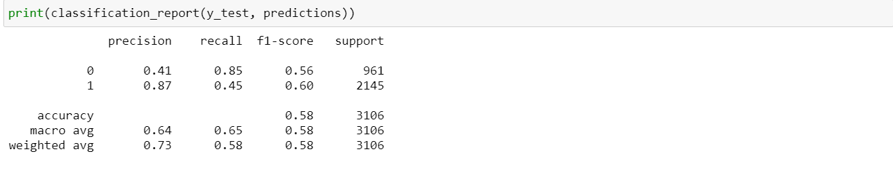
Model #1 – Logistic Model w/ class weights (2 largest classes)
Classification report for the Logistic Regression model shows good precision for the majority class (labeled 1), but poor precision for the minority class. This is to be expected: if the model decided to label an observation =1, it could

Slide 13
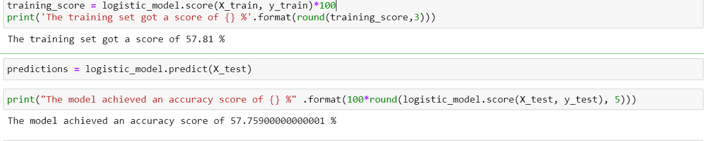
Model #1 – Results
Because of the poor results of the first attempt at model fitting (both test and training accuracy score ≈ 60%; signs of model underfitting data)

Slide 14
Model #2 – SVM(Support Vector Machines) w/ weights
A more robust model, Support Vector Machine, was chosen to improve the performance of the Logistic Regression Model. SVMs can find high order differentials between the classes.

Slide 15
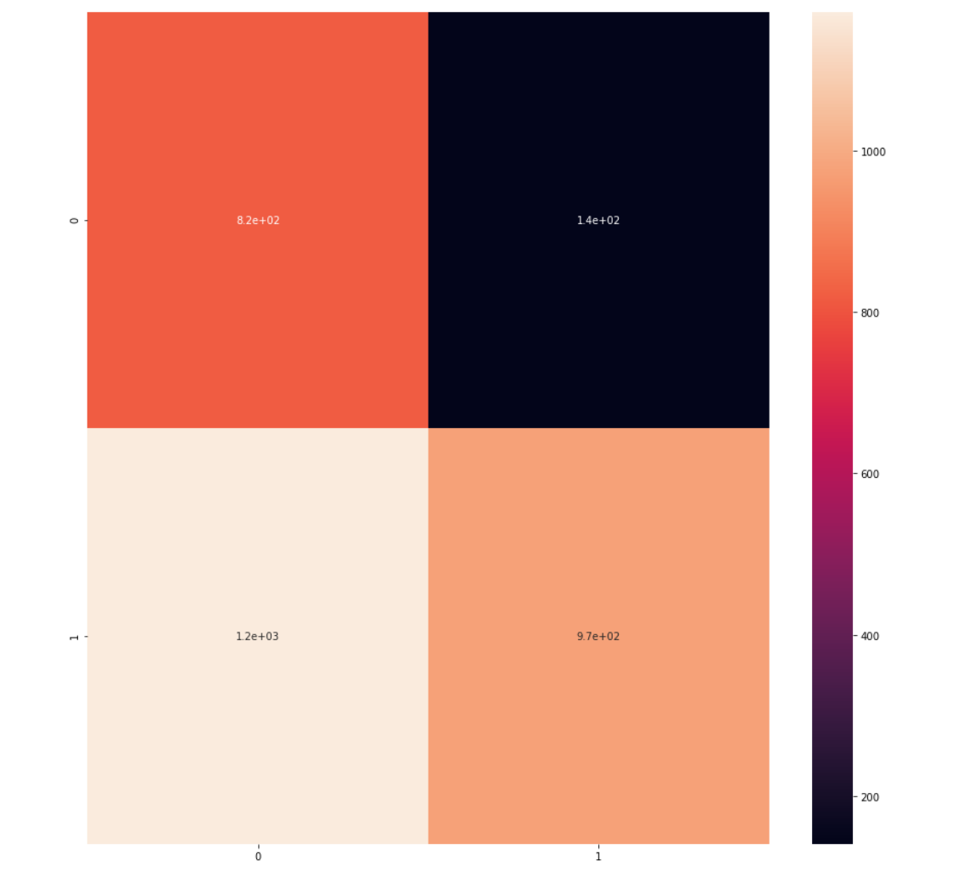
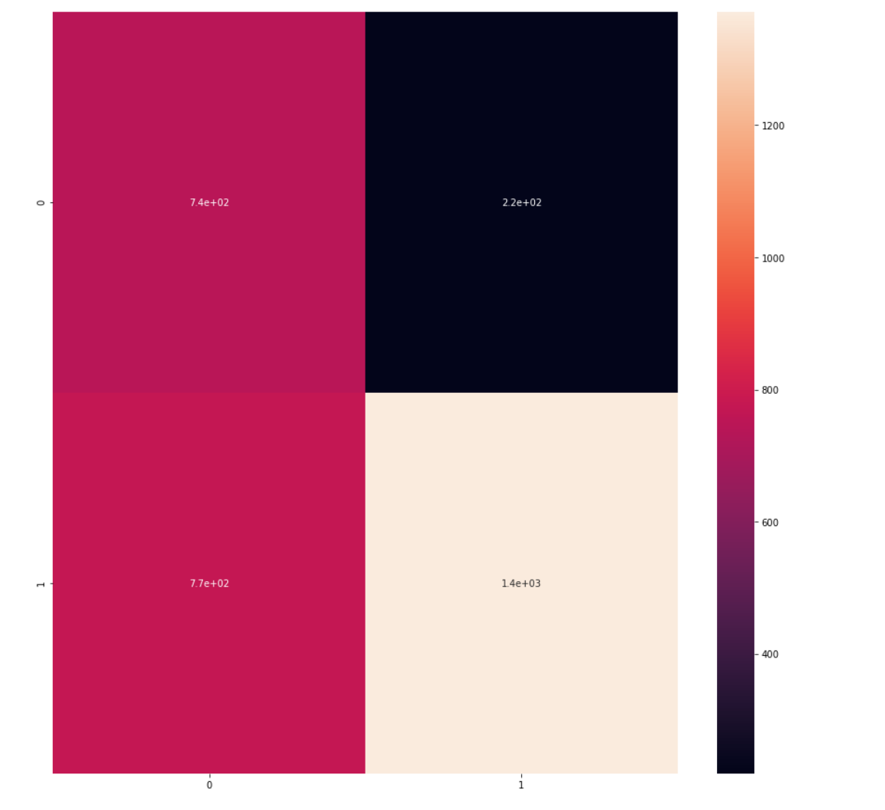
Model #2 Results
The accuracy scores of the first and second models are quite similar, but the confusion matrix tells a different story.
(Logistic Regression) (Support Vector Model)

Slide 16
Model #3 – Logistic Regression w/SMOTE analysis
Results have shown that assigning weights does not have a profound effect on teaching the model to handle severe class imbalance.
Model will now be retrained, now with data balanced using SMOTE (Synthetic Minority Over-sampling Technique). This technique utilizes a Naïve Bayes approach to generate samples for the minority class.
We apply the approach to the training set only – we want to make sure the generated data performs accurate predictions on real data.

Slide 17
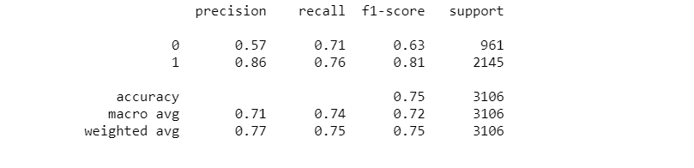
Model #3 Results
The results are promising- training the model using a full dataset dramatically improved the predictions of the minority set. There is room for strong improvement.
Next model will look to include more classes to introduce more variety into the model's features.

Slide 18
Model #4 – Model (Logistic Regression/SVM) with top 3 classes
The next model includes the top 3 classes in the data. These results were based on no class rebalancing from applying class weights or SMOTE analysis.

Slide 19
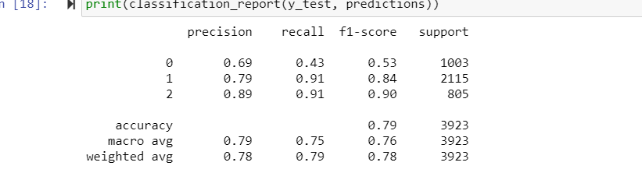
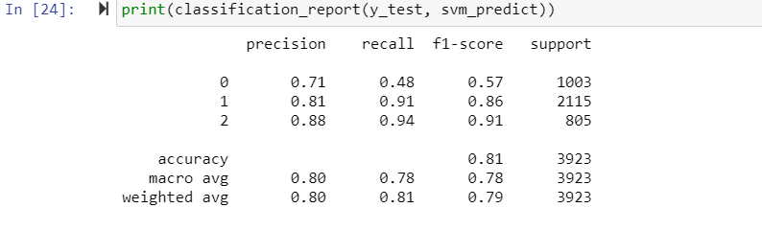
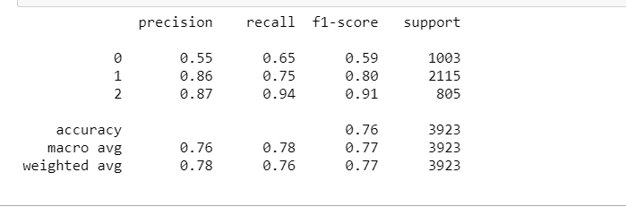
Classification Report from Logistic Model
Classification report from Support Vector Machine model
Classification Report from Support Vector Machine but dataset is balanced using SMOTE

Slide 20
Model #4 Results
The classification reports still show that the performance of the Logistic Regression and the Support Vector Machine models are quite similar, perhaps with the Support Vector Machine model having better recall (better confidence in models’ correct predictions), the results seems to surprisingly drop with the use of SMOTE analysis.

Slide 21
Fitting model with soft binning applied to all 3 color channels
With further examination of the images, a hypothesis was born: What if widening the scope of looking at more than just intensity values, but looking at the colors of the image will help possibly finding defining features of the dataset?

Slide 22
Model #6 – Using all 3 color channels to classify images
The same types of models (Logistic Regression and SVM) were utilized using all 3 color channels. The complete dataset now contained 18 features, an increase from the original 6 features.

Slide 23
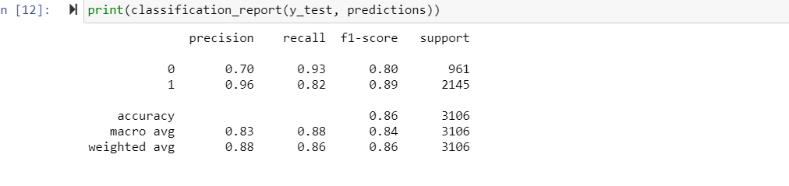
Model #6 results
The results are promising: the implementation of the color channels has improved the model’s predictions of the minority class. The best results(shown above) was with the Logistic Regression model.

Slide 24
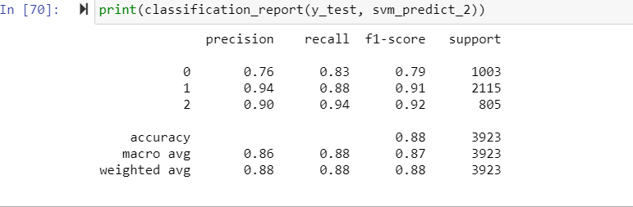
Model #6 (3 classes)
Implementing SMOTE analysis on the 3 largest classes yielded impressive results as well
The models shows that I can handle predictions with the 3 largest classes rather well.

Slide 25
Model of Full Dataset (18k images)
The results of the model when given all 15 classes is quite poor, but that is expected as the last 3 classes have <50 image each. Model results show that the model does perform well (high accuracy, recall, f-1 score > 60%) for the top 5-6 classes.

Slide 26
Conclusion
Having large balanced datasets is a major factor in the performance of a model. Generating instances using SMOTE can be helpful, but improvement is limited and perhaps a more robust method is needed for severe imbalanced datasets (image rotation, resizing, etc)
Common solutions for image processing utilize Keras, Pytorch, and complex deep learning architecture such as CNN (Convolutional Neural Networks), but we have shown that the simpler methods can still achieve high accuracy.
This approach can be useful for other image types, such as X-rays, MRI, and more.

Slide 27
Further Improvements
Use of blob detection to detect local structures within annotated cell.
Changing the centers, or standard deviation to achieve greater distinction in features.
Using deep learning is possible (CNN, GAN, etc.) (current dataset poses issues)
Combining similar classes to simplify the model. Resulting model predictions will be less precise, but accuracy may improve.

Slide 28
Contact
I would love to hear feedback on this project, and potential errors that could be in my analysis.
Email: abolajishiwoku@yahoo.com
LinkedIn: https://www.linkedin.com/in/abolaji-shiwoku-6b08361a3/
Python packages used: Pandas, OpenCv, Scipy, Sckit-Learn, Numpy

